Slide 1

Dynamic Memory Allocation
Dynamic memory is memory that is allocated at run-time.
It is allocated from a region of memory that we call the heap.

Slide 2

What is dynamic memory allocation?
The act of allocating memory for variables on the heap (or called free store) during program run-time.
Quite different than compile time (static) allocation:
Compile time allocation (CTA) means memory for named variables is allocated by the compiler at compile time,
Dynamic memory allocation (DMA) means memory is allocated on-the-fly during run-time.
CTA requires the exact size and type of storage at compile time, DMA is calculated and allocates the exact memory it needs during run-time.

Slide 3

Why is dynamic memory allocation good?
Stack space is limited.
We sometimes want variables to last beyond the lifetime of its current scope:
Variables on the stack don’t last beyond its current scope.
Variables dynamically allocated on the heap can be accessed beyond the current scope.
We don’t always know exactly how much memory is needed to run a program.
Solution: dynamically allocate memory when it’s needed, however much is needed.
But how do we dynamically allocate memory?

Slide 4
Dynamic memory allocation
There are three standard C library functions to allocate memory, all of which are defined under stdlib.h
malloc(), calloc(), and realloc()
These three functions dynamically allocate memory on the heap and returns a pointer to the allocated memory
Allocated memory must be freed using free().
Not freeing allocated memory can lead to depletion of system resources.
This is called a memory leak.

Slide 5
The Heap
A large region of unmanaged, anonymous memory.
Only limitations are your computer’s physical limitations.
Slower to read from/write to due to the need for pointers.
Variables using heap memory can be accessed globally with access to the pointer.
A benefit of using pointers; much easier to pass around pointers for large data structures.
Possible memory fragmentation can occur over time as blocks of memory are allocated and deallocated.

Slide 6
malloc()
Defined as:
void* malloc(size_t size)
Returns a pointer to [size] bytes of uninitialized memory allocated on the heap.
The memory allocated by malloc() may contain junk data.
What happens when zero is passed as the specified number of bytes to allocate is implementation defined (avoid doing this).
Doesn’t check for overflow of [size] if it’s the result of an arithmetic operation, unlike calloc().

Slide 7

Tracking memory usage
Operating system needs to track allocation state of memory
Regions that are available to hand out
Regions that are in use
Possibly what they’re being used for
Multiple approaches to doing this
Bitmap
Linked list
Buddy allocation
Slab allocation
Techniques also used for tracking free / allocated storage space

Slide 8

Tracking memory usage:
bitmaps
A
B
C
D
8
16
24
32
11111100
Memory regions
Keep track of free / allocated memory regions with a bitmap
One bit in map corresponds to a fixed-size region of memory
Bitmap is a constant size for a given amount of memory regardless of how much is allocated at a particular time
Chunk size determines efficiency
At 1 bit per 4KB chunk, we need just 256 bits (32 bytes) per MB of memory
For smaller chunks, we need more memory for the bitmap
Can be difficult to find large contiguous free areas in bitmap
00111000
01111111
Bitmap
11111000

Slide 9
Tracking memory usage:
linked lists
Keep track of free / allocated memory regions with a linked list
Each entry in the list corresponds to a contiguous region of memory
Entry can indicate either allocated or free (and, optionally, owning process)
May have separate lists for free and allocated areas
Efficient if chunks are large
Fixed-size representation for each region
More regions → more space needed for free lists
Notes:
Start here on Tuesday 5/1.

Slide 10
Allocating Memory
Search through region list to find a large enough space
Suppose there are several choices: which one to use?
First fit: the first suitable hole on the list
Next fit: the first suitable after the previously allocated hole
Best fit: the smallest hole that is larger than the desired region (wastes least space?)
Worst fit: the largest available hole (leaves largest fragment)
Option: maintain separate queues for different-size holes

Slide 11
Buddy allocation
Allocate memory in powers of two
Good for objects of varied sizes
Split larger chunks to create two smaller chunks
When chunk is freed, see if it can be combined with its buddy to rebuild a larger chunk
This is recursive...
Allocating memory
Freeing memory

Slide 12
Freeing memory
Allocation structures must be updated when memory is freed
Easy with bitmaps: just set the appropriate bits in the bitmap
Linked lists: modify adjacent elements as needed
Merge adjacent free regions into a single region
May involve merging two regions with the just-freed area
A
X
B
A
B
A
X
A
X
B
B
X

Slide 13
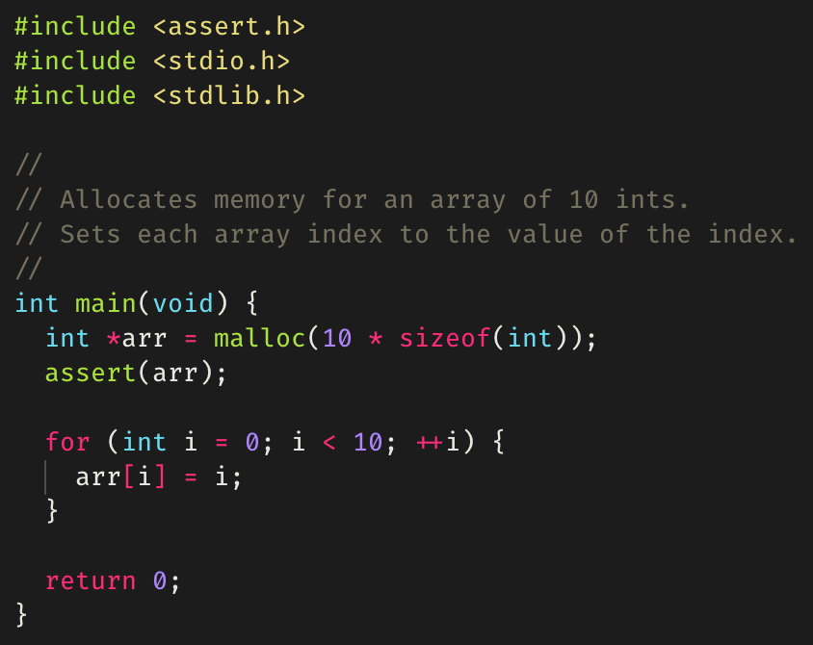
Example of malloc()

Slide 14
calloc()
Defined as:
void* calloc(size_t nmemb, size_t size)
[nmemb] denotes the number of objects and [size] the size of each object.
Returns a pointer to [nmemb] * [size] bytes of allocated memory on the heap, in which each byte has been initialized to zero.
Like malloc(), behavior when [nmemb] is zero is implementation defined.
Generally slower than malloc(), but the tradeoff is that the contents of the allocated memory are known since it’s zeroed out.

Slide 15
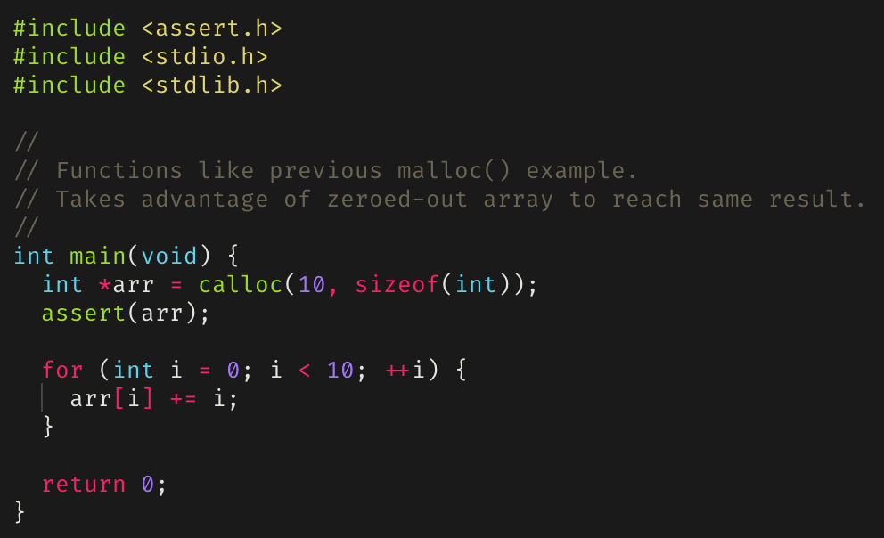
Example of calloc()

Slide 16
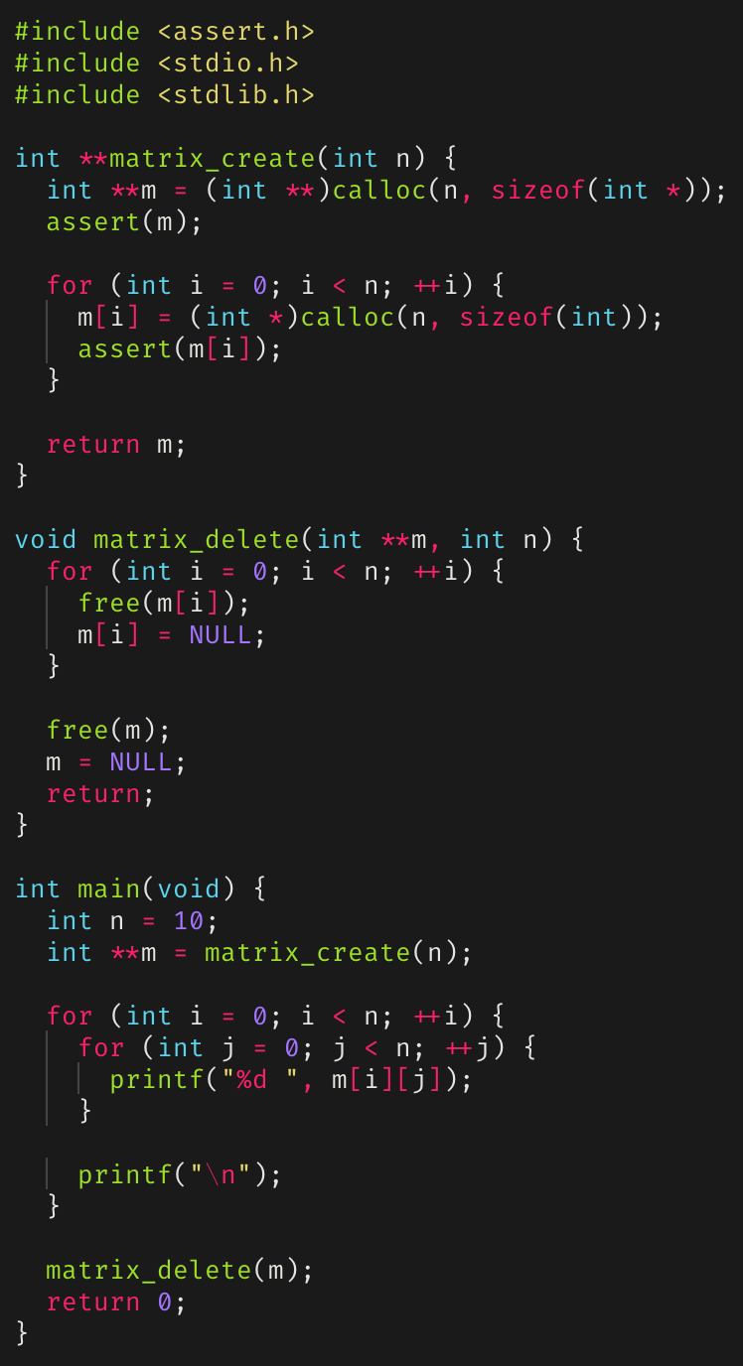
Dynamic Memory Allocation example: A dynamic n × n matrix
Example of dynamically allocating an n × n matrix.
The destructor, matrix_delete(), iterates and frees the allocated memory for each pointer.

Slide 17
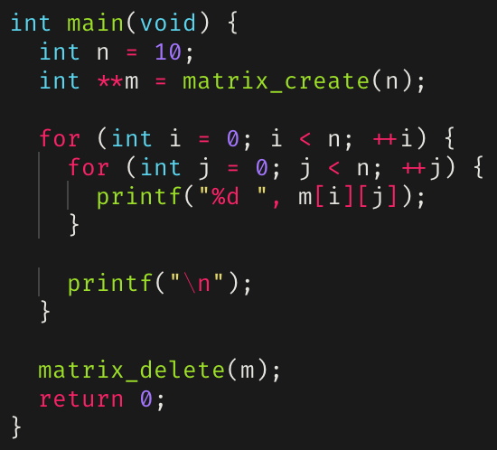
Dynamic matrix: main()

Slide 18
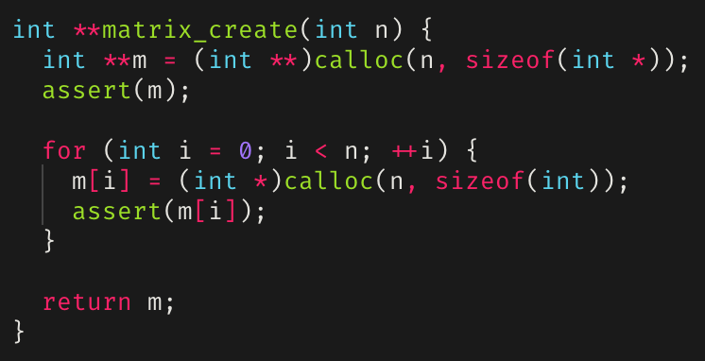
Dynamic matrix matrix_create()

Slide 19
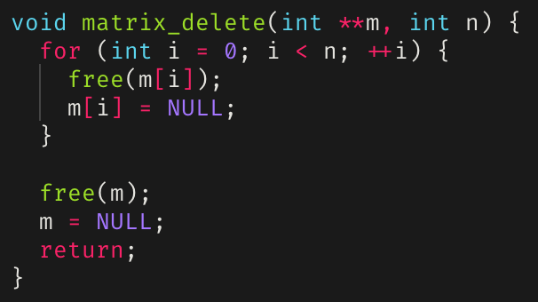
Dynamic matrix
matrix_delete()

Slide 20
realloc()
Defined as:
void *realloc(void *ptr, size_t size)
Reallocates [ptr] to newly point at [size] bytes of allocated memory on the heap.
This is not strictly true; what realloc() actually does is deallocate the old object pointed to by [ptr] and return a pointer to [size] bytes of allocated but uninitialized memory.
If [size] is greater than the size of the originally allocated block of memory, the contents of the returned pointer contains everything from the original block, but the extra allocated memory is uninitialized
Else if [size] is less than the size of the originally allocated block of memory, the contents of the returned pointer contains exactly the beginning [size] bytes from the original block

Slide 21
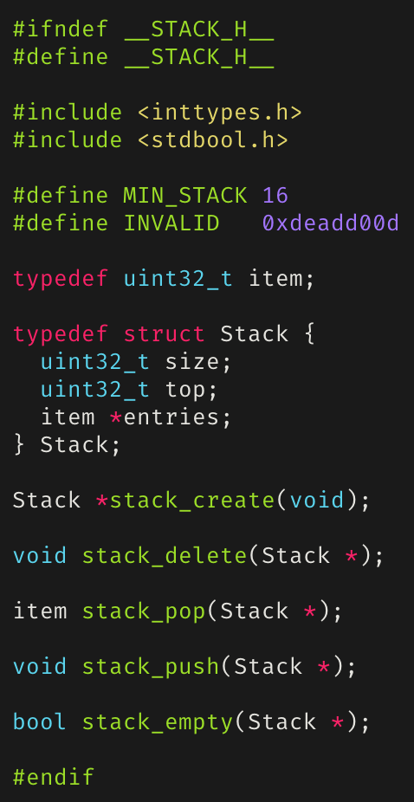
A Dynamically Growing Stack

Slide 22
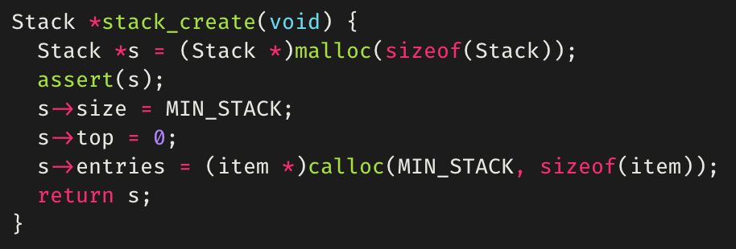
Dynamic Stack: stack_create()

Slide 23
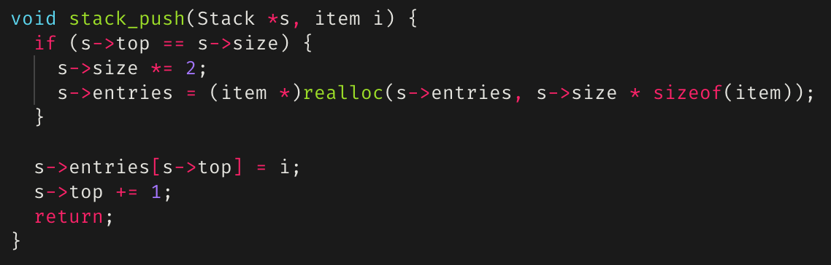
Dynamic Stack: stack_push()

Slide 24
free()
If we allocate memory, we must also be able to deallocate (or free) memory.
Another standard C library functions specifically for deallocating memory allocated by malloc(), calloc(), or realloc().
Defined as void free(void *ptr)
Deallocates the memory space pointed to by [ptr].
Memory leaks occur if allocated memory isn’t freed.
Segmentation faults/core dumps can occur if a program tries to access memory locations that it isn’t allowed to access.
Pointers that have been freed should be set to NULL to mitigate use-after-free vulnerabilities.

Slide 25
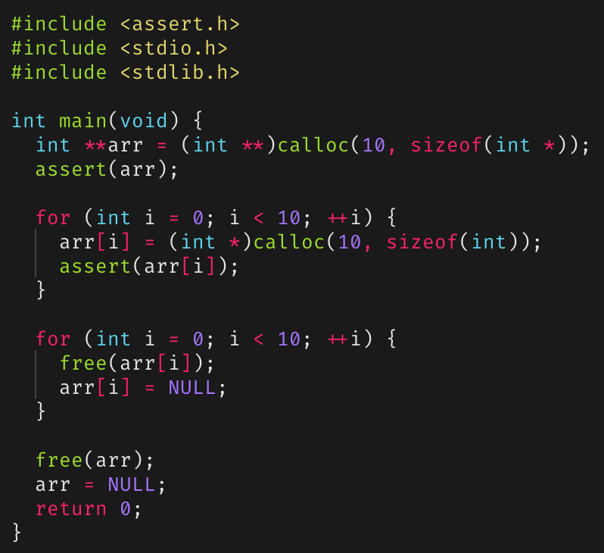
Example of free()

Slide 26
Detecting Memory Leaks and Segmentation Faults
Memory leaks and segmentation faults, as well as other errors, can be detected using gdb, infer, or valgrind
Should be used in tandem when debugging.

Slide 27

valgrind
A collection of dynamic analysis tools.
Usually used for its memcheck tool, which can detect:
Use of uninitialized memory.
Reading/writing memory after it has been freed.
Reading/writing off the end of allocated blocks of memory.
Reading/writing inappropriate areas on the stack.
Memory leaks – where pointers to malloc’d blocks are lost forever.
Useful command line flags/options for valgrind
--leak-check=full
--show-leak-kinds=all

Slide 28
Static versus dynamic analyzers
Static analyzers, like infer, operate by analyzing the source code for a program before it’s run.
Code is compared against a set (or multiple sets) of coding rules for bugs.
Only surface level; can’t check if a function behaves completely as it’s supposed to when it’s executed.
Dynamic analyzers, like valgrind, operate by tracking down errors that occur during program execution.
Good for checking if the program executes as it’s supposed to,
Can only analyze what happens during execution,
Things that don’t occur during execution aren’t analyzed.
Let’s see examples of differences in analysis output for infer and valgrind.

Slide 29
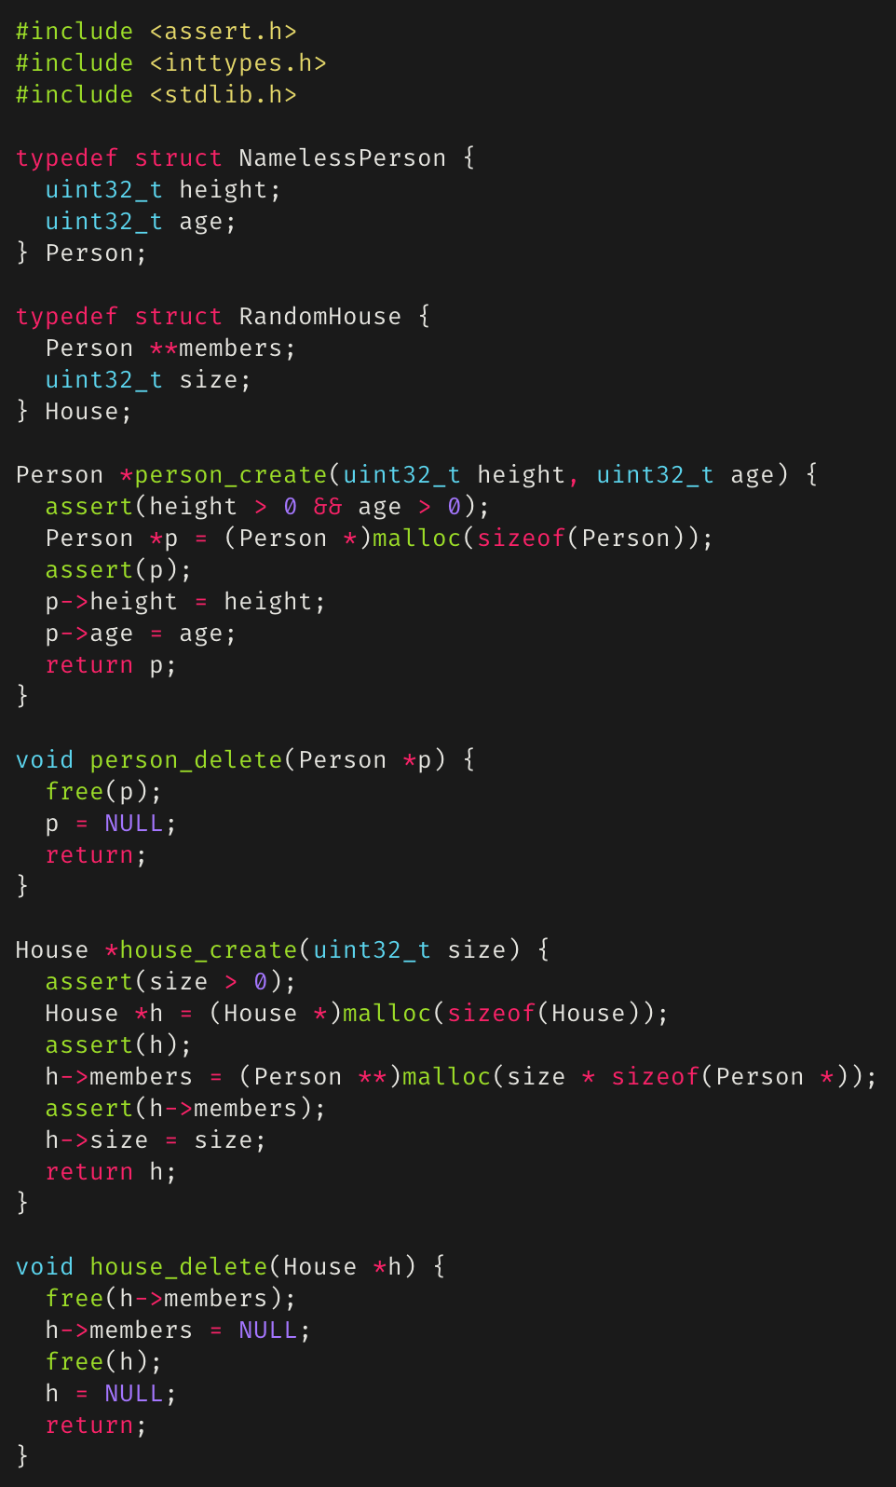
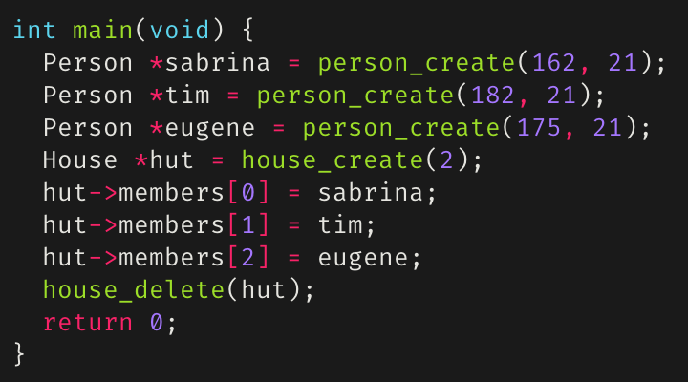
Debugging with infer
Consider the person/house code module on the right.
Now consider the main function below:
Is there anything wrong?
Let’s statically analyze this with infer.

Slide 30
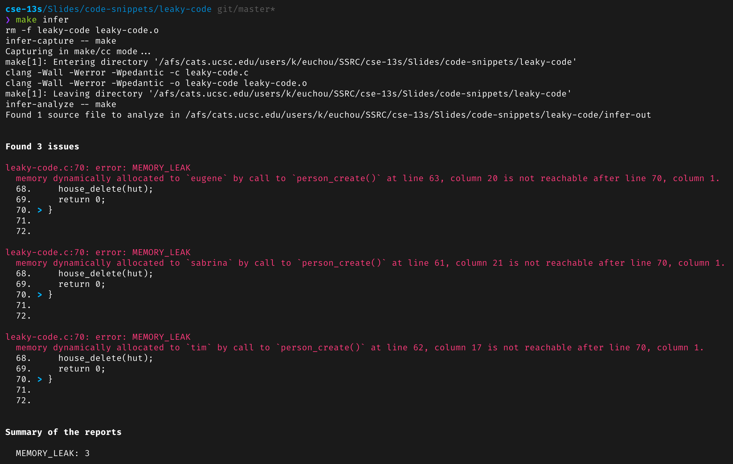
Debugging with infer (cont’d)
Running infer using:
infer-capture -- make
infer-analyze -- make

Slide 31
Debugging with infer (cont’d)
We can see that we have three memory leaks, all of which are from the fact that we allocated memory for three person *’s but never freed them.
We can fix this by adding a loop to house_delete() to call person_delete() for each person in the members field of a house and to free the third person in the main function.
However, the main function only allocated space for two people in the house, but infer didn’t report anything when the main function added a third person to the house.
This is where we further debug with valgrind.

Slide 32
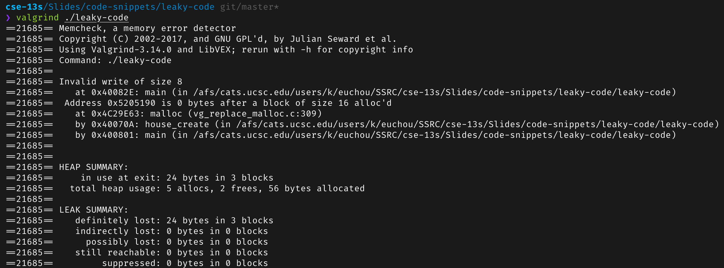
Debugging with valgrind
valgrind output for the same program checked earlier with infer:

Slide 33
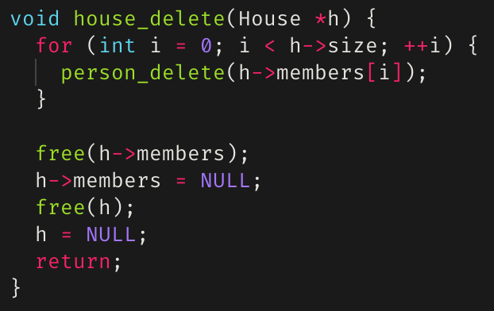
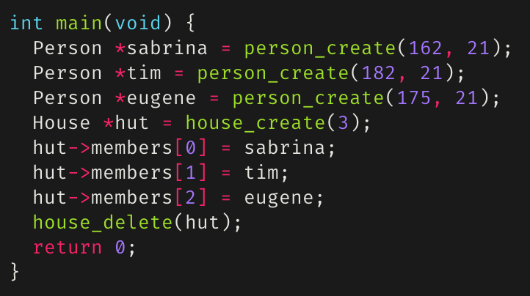
Debugging with valgrind (cont’d)
As we can see, we still see the memory leaks caused by the three persons, and now we also see that trying to add a person to the house caused an invalid write
We can fix house_delete() as seen on the right:
And we can either change the main function to either not add the third person to the house and call person_delete()on them, or instantiate the house to fit 3
Applying the above changes will result in a leak and error free program

Slide 34
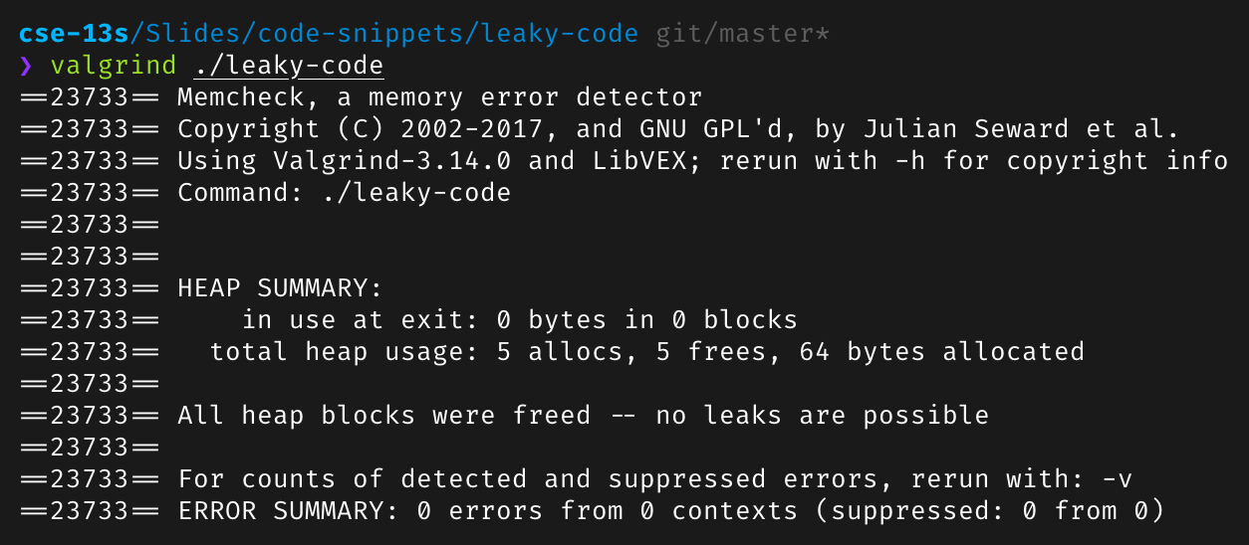
valgrind() on debugged program
Looking good!
But what about infer?

Slide 35
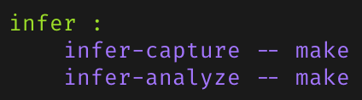
infer
A static analysis tool to detect bugs in C, C++, and Java.
Checks for null pointer exceptions, resource leakage, race conditions, and missing lock guards.
On the left is an example of a make infer target in a Makefile.

Slide 36
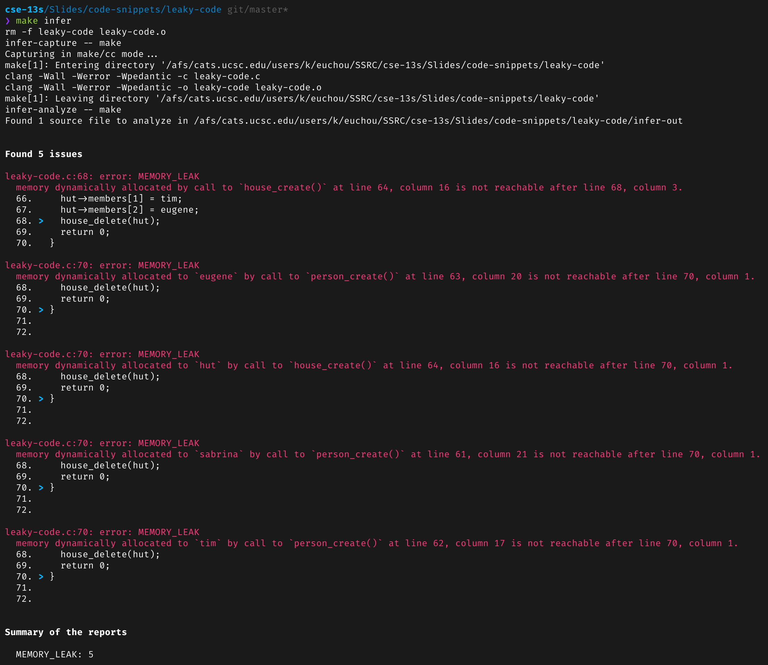
infer on a debugged program
There are still errors!
This is “okay”
infer is far from perfect
What are reported as memory leaks are freed later on in the code in other functions.
Any errors reported by infer that aren’t correct must be explained in your README.md.

